Slide 1
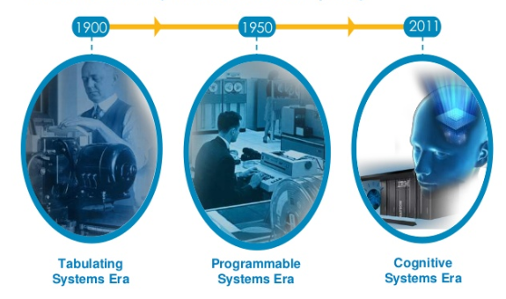
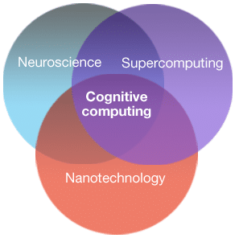
Introduction of Cognitive computing
Background-
Technology for development of computer system/mechanism which have ability to think and react like human mind.
Increase in unstructured data, over the past few years led to the development of a new type of computer system.
Cognitive systems explores the data, find new correlations and new context to provide new solutions.

Slide 2
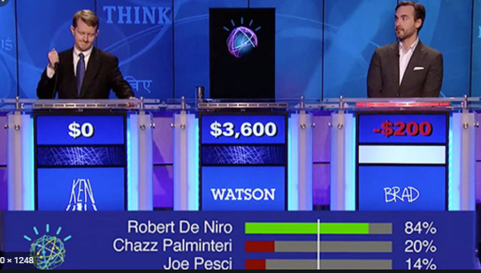
Introduction of IBM Watson
In Feb 2011 Watson creates history by defeating two famous human players in famous TV show Jeopardy.
Watson was Question-Answering (QA) system that applies advanced natural language processing, information retrieval, knowledge representation, automated reasoning and machine learning technologies.
Notes:
https://www.ibm.com/in-en/cloud/watson-studio,
https://eu-gb.dataplatform.cloud.ibm.com/home?context=wdp

Slide 3
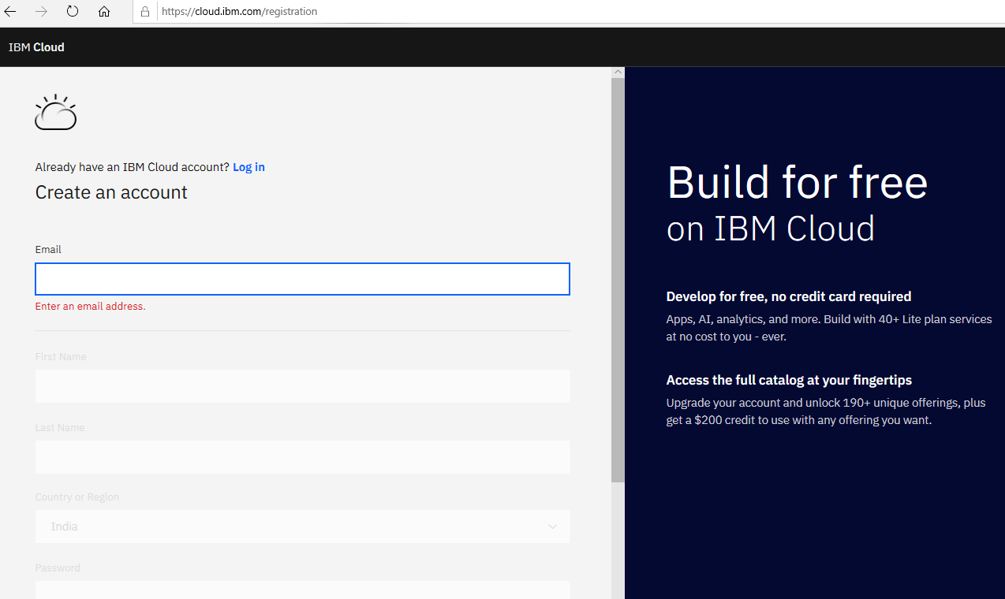
Step 1: Sign Up/ log into IBM Cloud
https://cloud.ibm.com/login

Slide 4
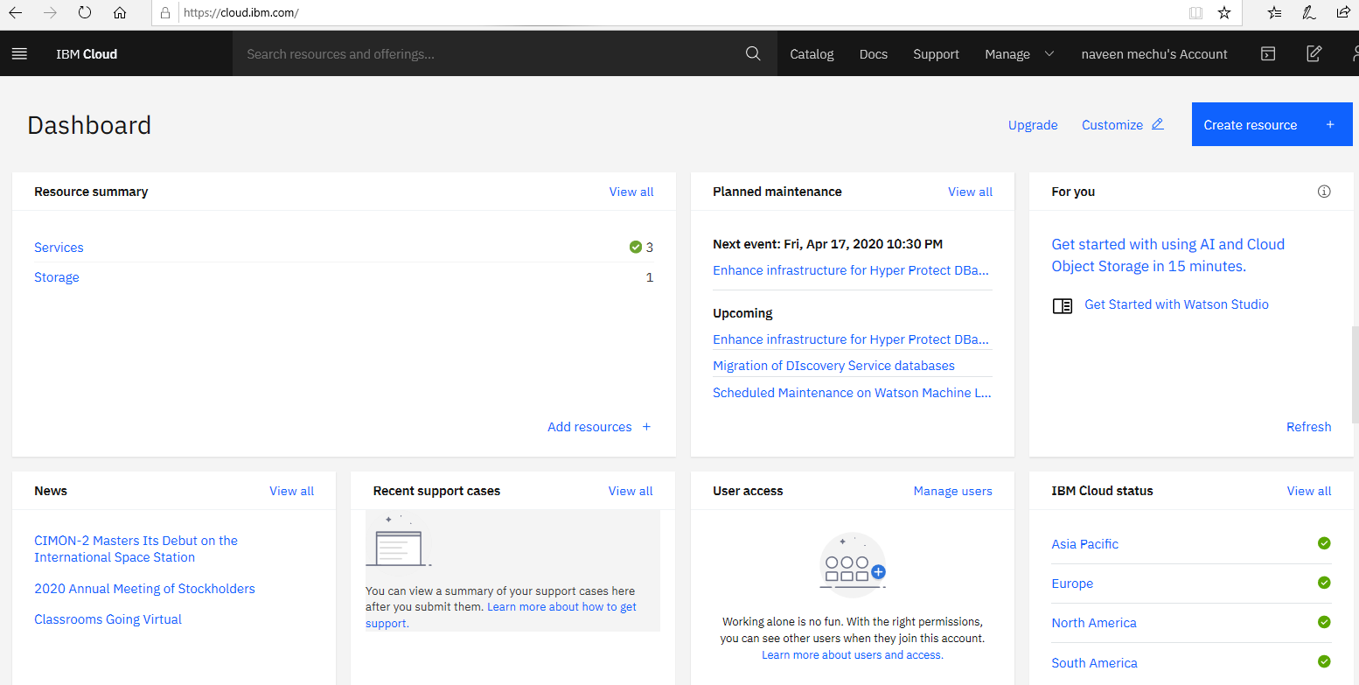
IBM Cloud dashboard after login

Slide 5
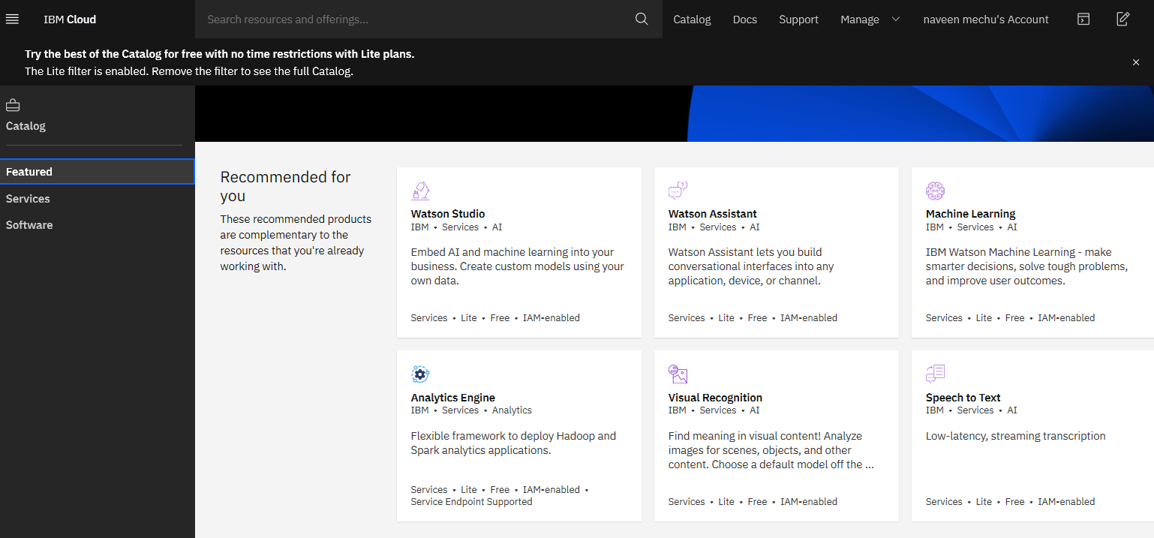
Step 2: Click on Catalog->Watson Studio

Slide 6
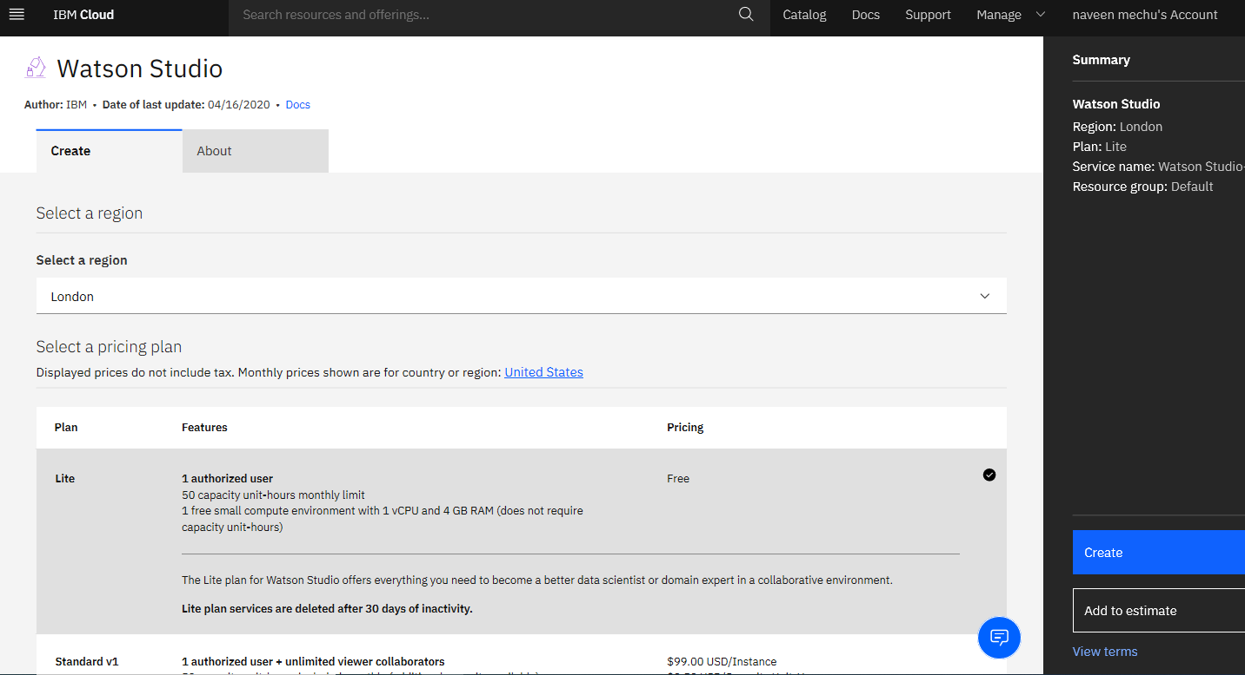
Step 3: Click on create button

Slide 7
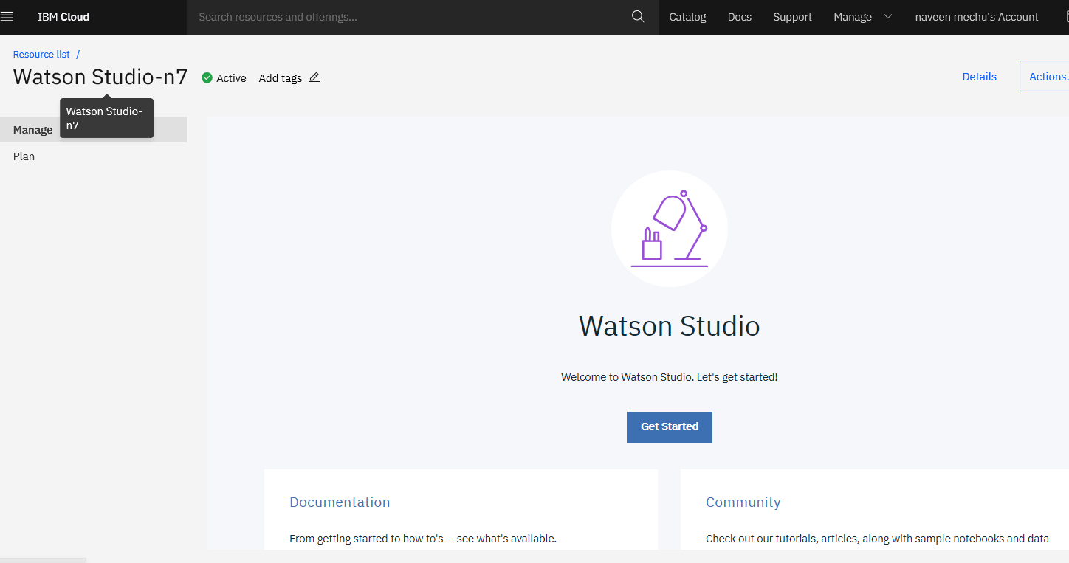
Step 4: Launch Watson studio

Slide 8
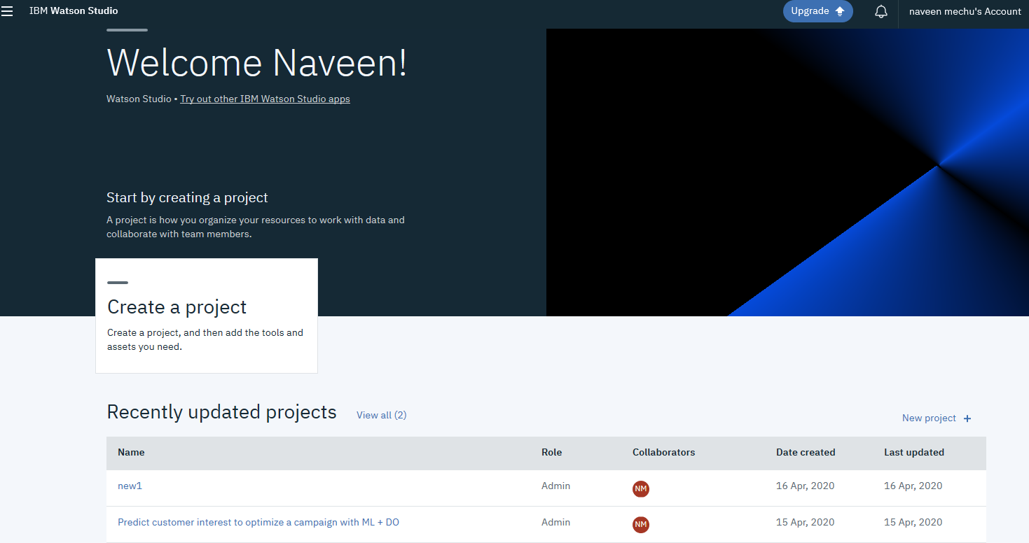
Step 5: Create Project

Slide 9
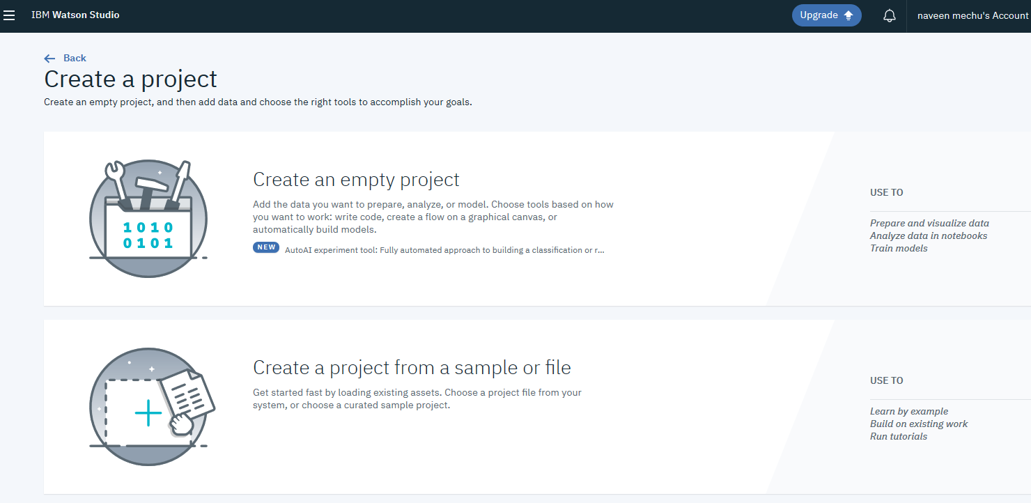
Step 6: Select an Create Project

Slide 10
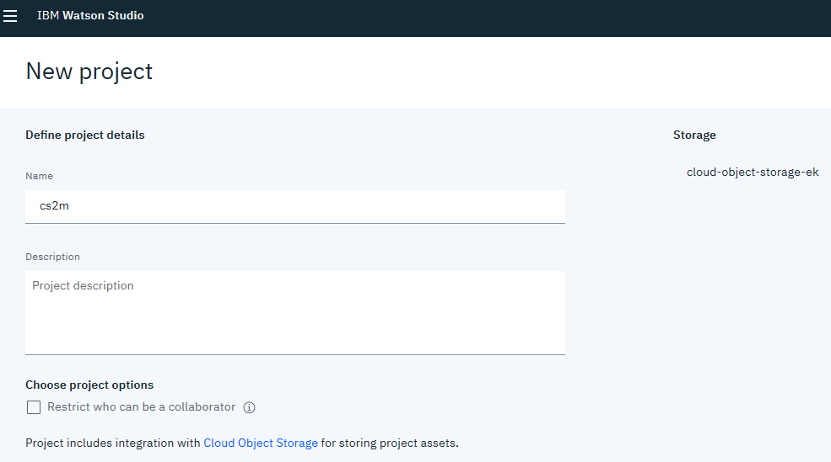
Step 7: Define Project name & description

Slide 11
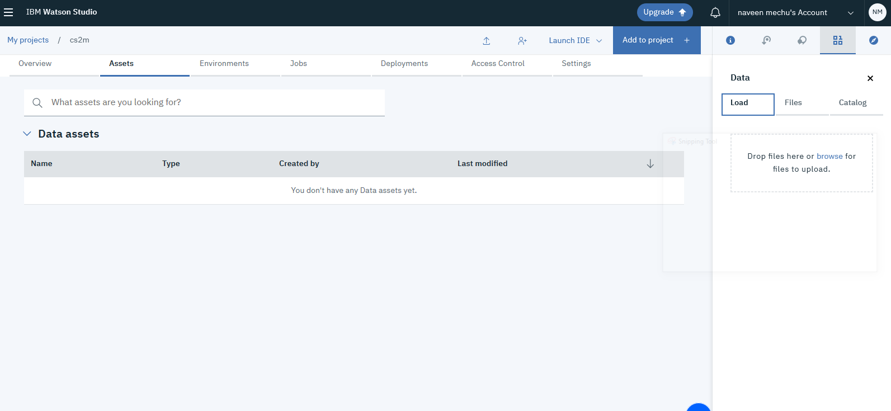
Step 8: Open Asset Tab

Slide 12
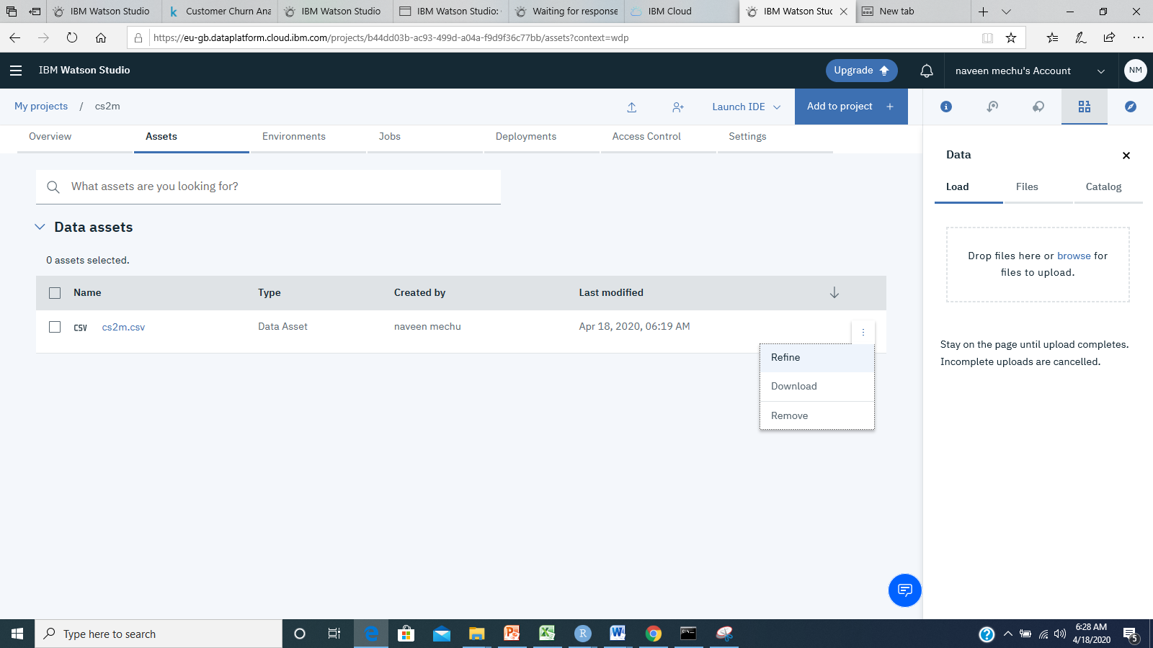
Refine data
Step 1: Select Refine

Slide 13
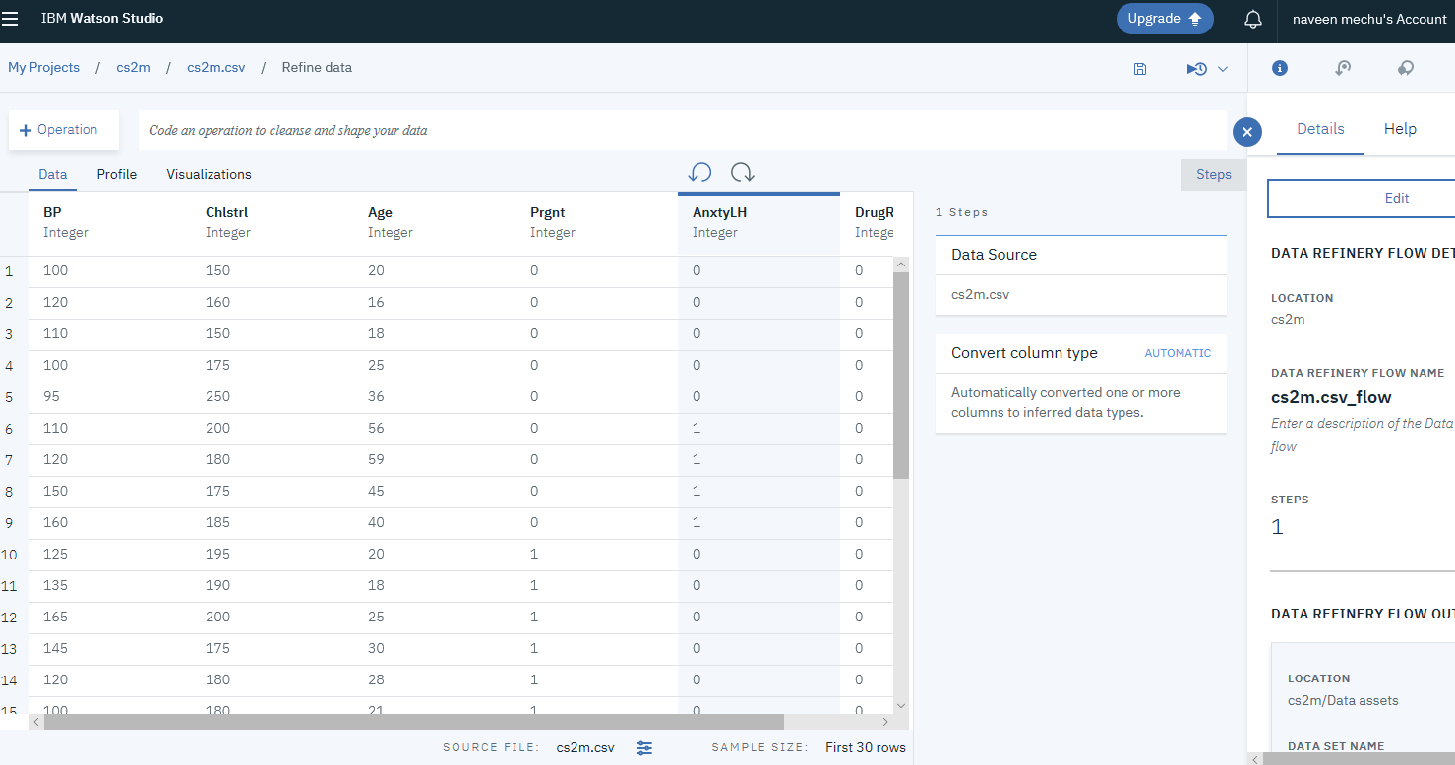
Step 2: Select Operations

Slide 14
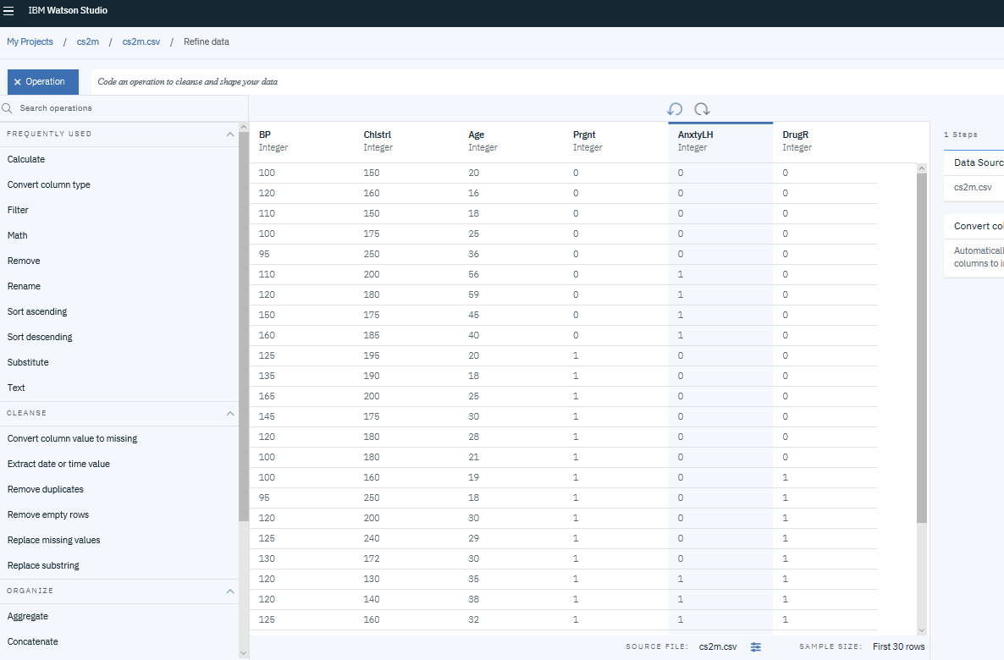
Step 3: Select Operations as desired

Slide 15
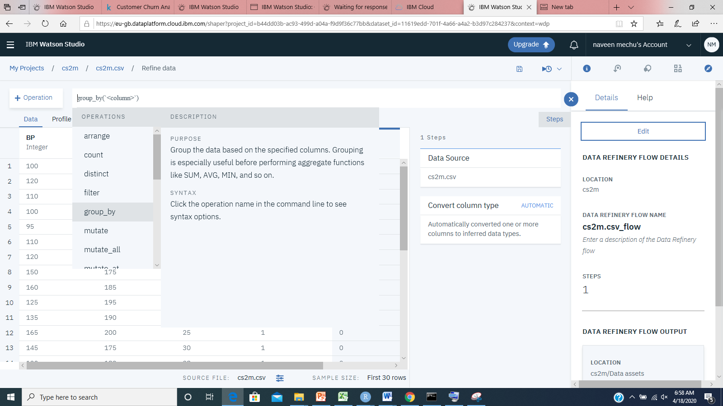
Step 4: Code an operation to cleanses & reshape data

Slide 16
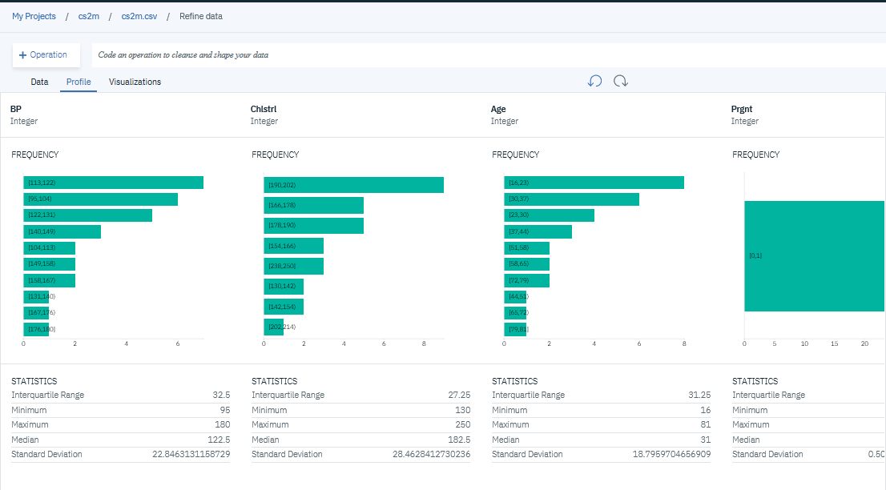
Step 5: Profile Tab give frequency & Statistics of each column

Slide 17
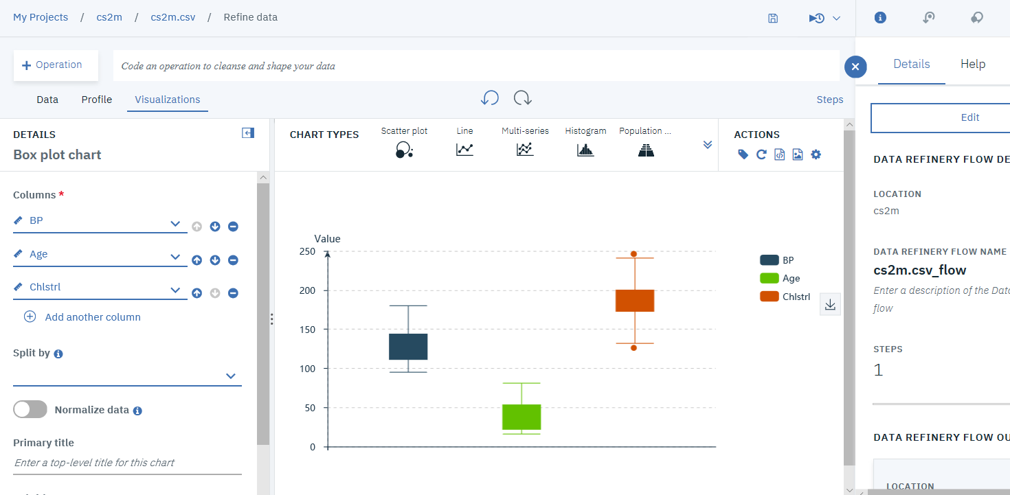
Step 5: Visualization Tab gives graphical visualization of data

Slide 18
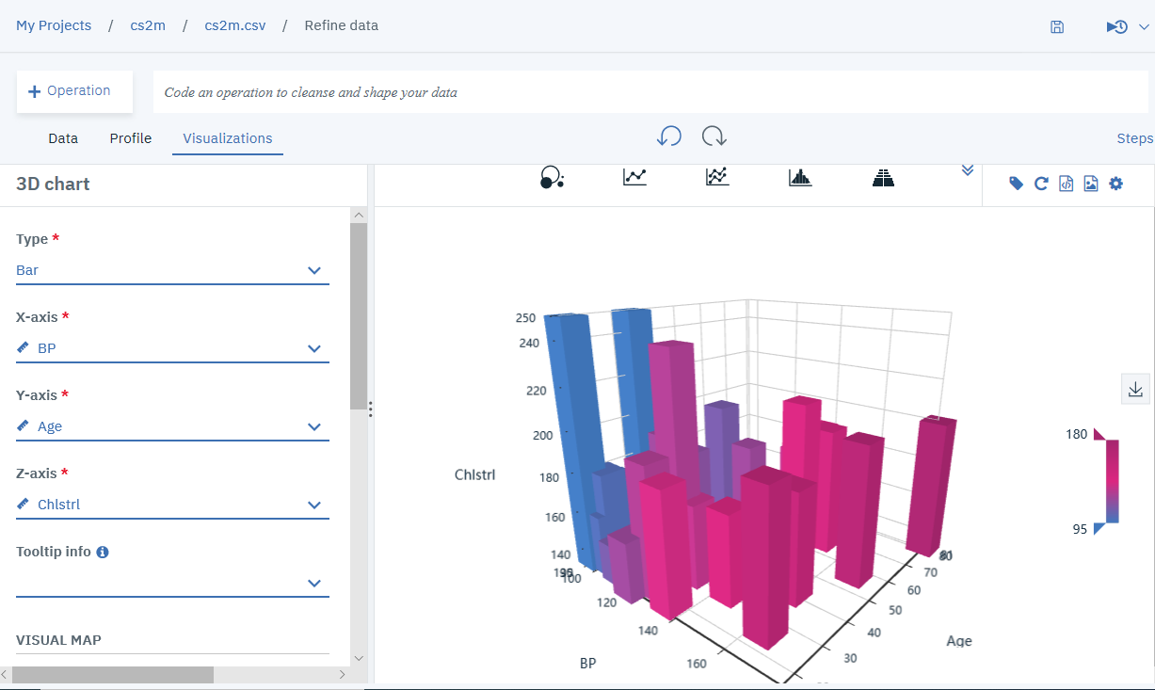
Visualization (3D Plot)

Slide 20
https://eu-gb.dataplatform.cloud.ibm.com/home?context=analytics
Notes:
https://bookdown.org/caoying4work/watsonstudio-workshop/dr.html

Slide 21
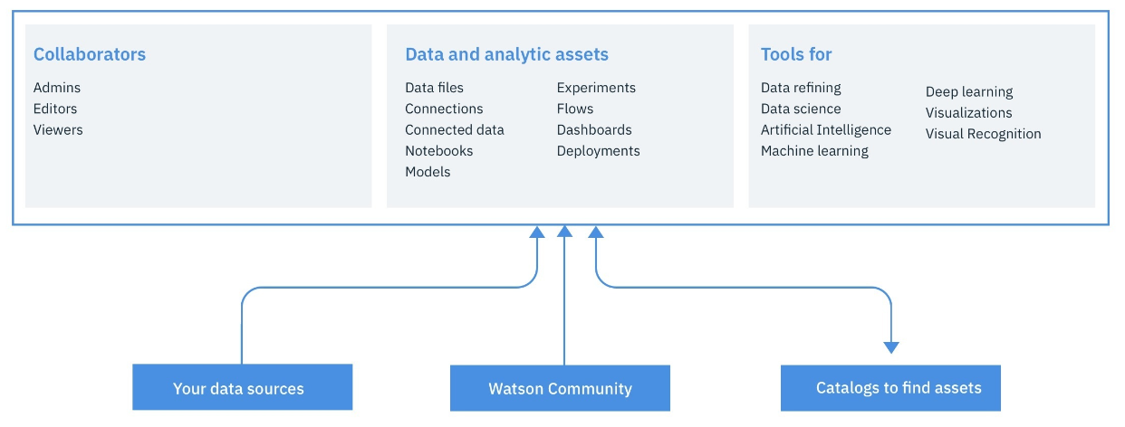
Notes:
It give you the environment and tools to solve business problems by collaboratively working with data. You can choose the tools needed to analyze and visualize data; to cleanse and shape the data; to ingest streaming data; or to create, train, and deploy machine learning models.

Slide 22
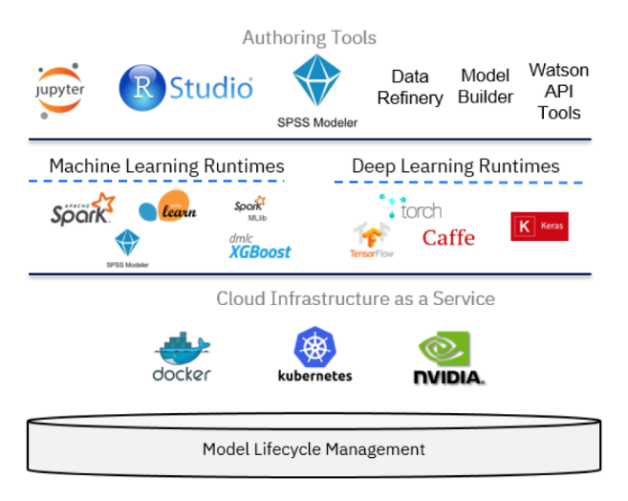
Watson Studio is based on a variety of open source technology and IBM products.

Slide 23
Data visualization, preparation, and transformation using IBM Watson Studio
Step 1- Create IBM Cloud Object Storage service

